Slide 1

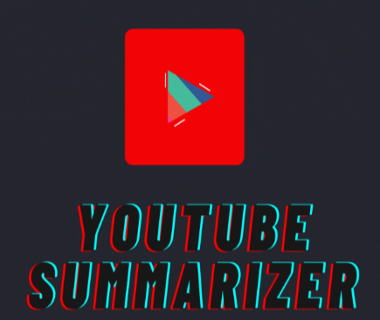
YouTube Transcript Summarizer
The YouTube Transcript Summarizer extracts and summarizes YouTube video transcripts using advanced NLP techniques, including SpaCy and BART models. It offers both text and audio summaries for enhanced accessibility. This tool streamlines information retrieval from videos, making content consumption more efficient.
Notes:
1

Slide 2


Meet the Team
Shaik Shabber Ali - O190106
Penta Yaznasri - O191044
Avvaru Mohana Lakshmi – O190529
Vantakula Prasanthi - O190783
Gogula Yuvaraj - O190822
Notes:
2

Slide 3

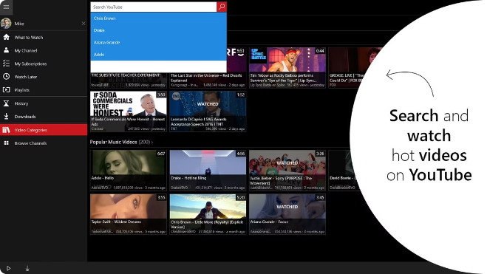
Introduction to the YouTube Transcript Summarizer
The YouTube Transcript Summarizer is a cutting-edge tool that utilizes natural language processing (NLP) techniques to condense lengthy YouTube video transcripts into concise summaries.
1
Automated Summarization
2
Time-Saving Tool
The system automatically extracts key information and phrases from the transcript, reducing the need for manual summarization.
This tool can significantly save time and effort by providing users with a quick overview of the video content.
3
Enhanced Comprehension
Summaries can help users understand the core ideas and arguments presented in the video more efficiently.
Notes:
3

Slide 4
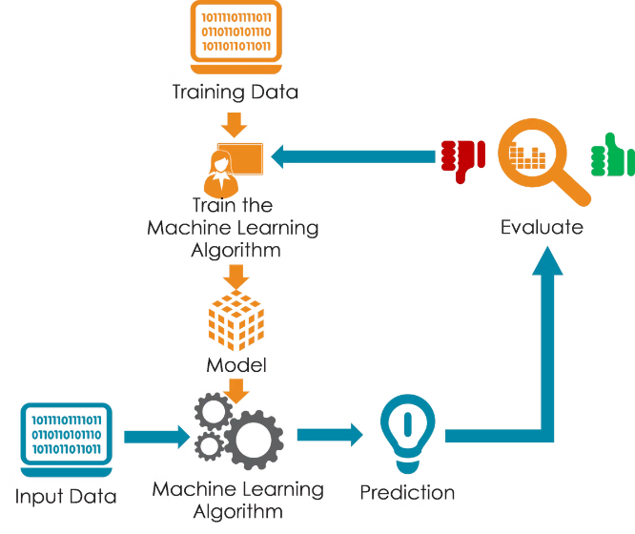
Proposed System
The proposed system employs a two-stage approach to summarize YouTube video transcripts. First, a pre-processing stage cleans and prepares the transcript data. Next, a summarization model, trained on a large dataset of transcripts, extracts key information and generates a concise summary.
1
Pre-Processing
This stage involves tasks such as removing irrelevant information, correcting grammatical errors and identifying key entities and concepts.
2
Summarization
The summarization model utilizes techniques like sentence ranking and extractive summarization to identify the most important sentences and phrases in the transcript.
3
Post-Processing
The final stage involves formatting the summary for readability and ensuring that it captures the essence of the video content.
Notes:
4

Slide 5
Existing Systems
Several existing systems address the challenge of summarizing YouTube video transcripts. However, many existing solutions rely on rule-based approaches, which can be inflexible and struggle with complex language structures.
Rule-Based Summarization
Machine Learning-Based Summarization
These systems rely on predefined rules to identify important sentences. They may struggle with complex language and nuances.
These systems leverage machine learning algorithms to learn patterns from data and produce more accurate summaries. They are more flexible and can handle complex language.
Notes:
5

Slide 6
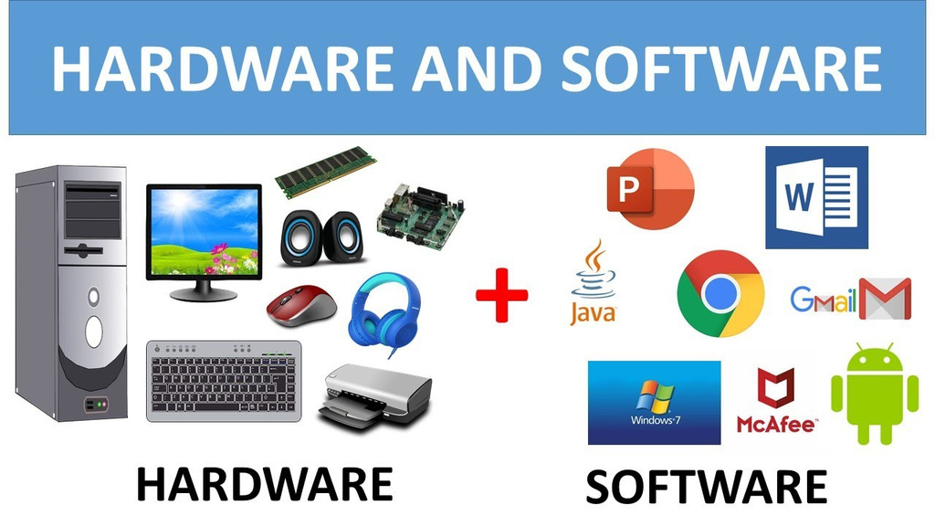
Software and Hardware
The YouTube Transcript Summarizer requires robust software and hardware infrastructure to handle large volumes of data and perform computationally intensive tasks.
Software
Python 3.x, Streamlit, Youtube Transcript API, SpaCy, Hugging Face Transformers(BART), gTTs
Hardware
A standard computer or server capable of running Python applications.
Internet access for fetching YouTube transcripts and dependencies.
Notes:
6

Slide 7
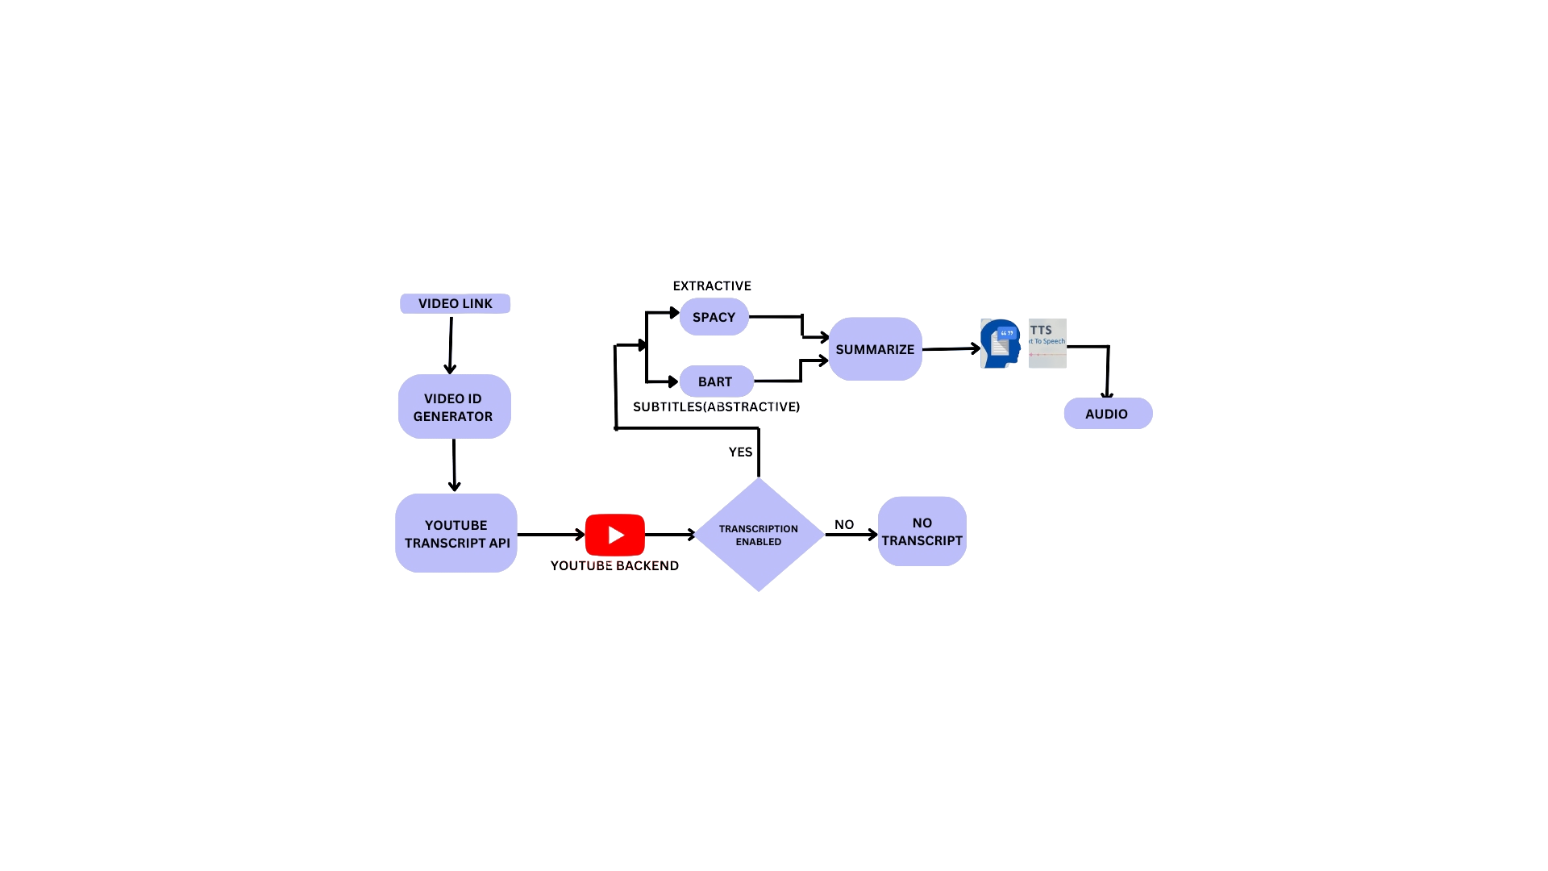
Working
Notes:
7

Slide 8
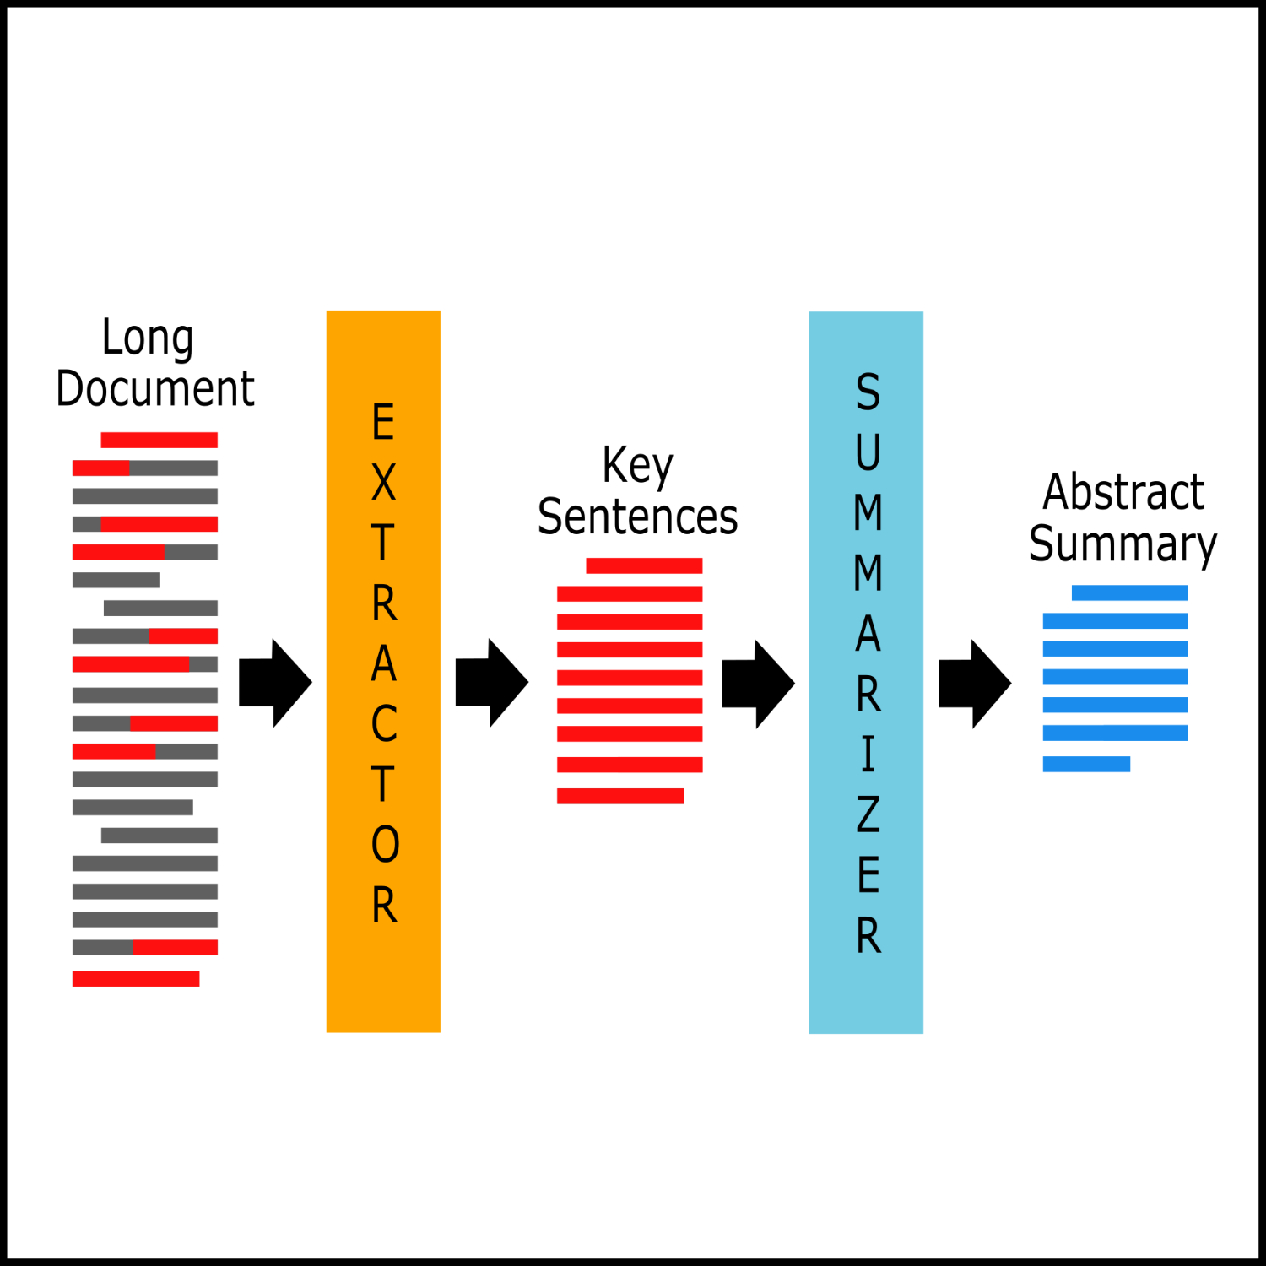
Abstractive
.
The abstractive YouTube summarizer transcript project aims to condense video content by generating concise, meaningful summaries that capture the essence of the video using advanced natural language processing techniques.
It goes beyond simple extraction by paraphrasing and restructuring information to produce coherent summaries that preserve key insights and context from the original content.
The abstractive YouTube summarizer transcript project simplifies complex videos into easy-to-understand summaries using advanced language processing.
Notes:
8

Slide 9
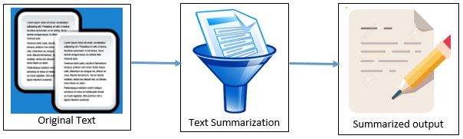
.
Extractive
In the YouTube Transcript Summarizer project, "extractive" summarization means creating summaries by selecting important sentences directly from the video transcripts.
It doesn't rewrite or reinterpret the content but stitches together the most relevant sentences to convey the main points succinctly.
This method simplifies summarization by relying on the existing text, ensuring that the summary remains faithful to the original content of the video.
Notes:
9

Slide 10

.
In the YouTube Transcript Summarizer project, Spacy is a helpful tool that processes the text from video transcripts.
It breaks down the text into meaningful parts like words and sentences, identifies different types of words (like nouns or verbs), and recognizes important names and phrases.
This helps make the summaries of video content more accurate and useful.
Notes:
10

Slide 11
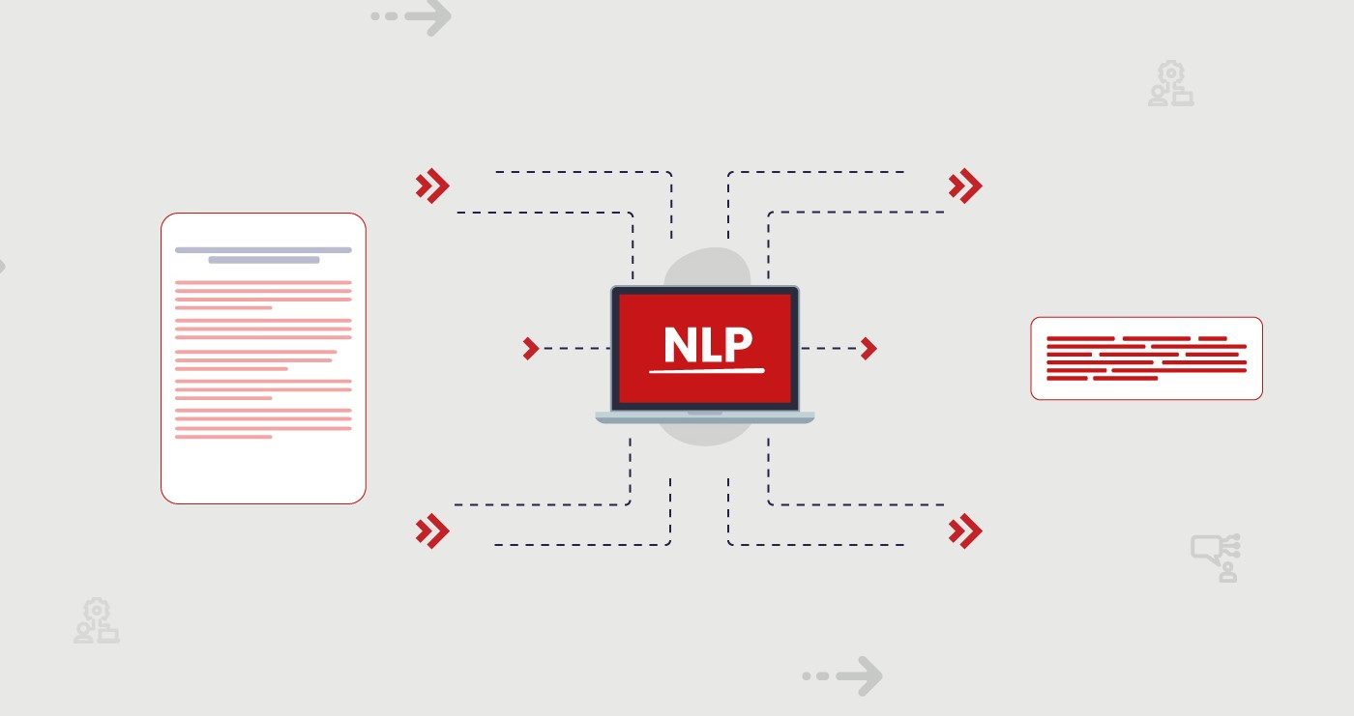
.
BART
BART (Bidirectional and Auto-Regressive Transformers) is a sophisticated language model developed by Facebook AI.
It excels in tasks like text generation and summarization by combining bidirectional understanding with auto-regressive generation capabilities.
BART can effectively summarize and rewrite text, making it valuable for applications requiring concise and coherent content generation, such as in summarizing YouTube videos.
Notes:
11

Slide 12





Tools
The development and deployment of the YouTube Transcript Summarizer require a suite of specialized tools for data analysis, model training, and evaluation.
Programming Languages
GitHub
Python is used for developing the algorithms and processing the transcript data.
Databases like MySQL or PostgreSQL are used to store and manage the large volumes of transcript data.
gTTs
Streamlit
gTTs stands for Goggle Text-to-Speech. It’s a Python library and CLI tool that interfaces with Google Translate’s text-to-speech API.
Streamlit is an open-source Python library used to create web applications for machine learning and data science projects quickly and easily.
Notes:
12

Slide 13

gTTs
GTTS (Google Text-to-Speech) is used to convert text summaries generated by natural language processing models into spoken audio.
This integration enhances accessibility by allowing users to listen to summarized video content, making it convenient for those who prefer auditory learning or have visual impairments.
Notes:
13

Slide 14

Streamlit is utilized as a user-friendly web application framework.
It enables the deployment of interactive and customizable interfaces for accessing and interacting with summarized video transcripts.
Streamlit simplifies the process of presenting summarized content to users, offering features such as sliders, dropdowns, and text inputs for enhanced user engagement and customization of the summarization output
Notes:
14

Slide 15

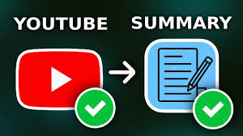



Overview
The YouTube Transcript Summarizer is an innovative system that tackles the challenge of summarizing lengthy video transcripts. It leverages the power of NLP techniques to produce accurate and concise summaries.
Transcript Acquisition
The system first retrieves the transcript from YouTube videos.
Pre-processing
The transcript is cleaned and prepared for analysis.
Summarization
A trained machine learning model generates a summary of the transcript.
Post-processing
The summary is formatted for readability and presented to the user.
Notes:
15

Slide 16


Objective
The primary objective of the YouTube Transcript Summarizer is to provide users with concise summaries of YouTube video transcripts, enabling them to quickly grasp the key information and ideas presented in the video.
Time Savings
Improved Comprehension
The system aims to save users time and effort by providing a summary instead of requiring them to read through the entire transcript.
Summaries help users understand the main points and arguments presented in the video more effectively.
Enhanced Accessibility
By providing concise summaries, the system makes video content more accessible to users who may not have time to watch the entire video.
Notes:
16

Slide 17

Advantages
The YouTube Transcript Summarizer offers several advantages over existing summarization methods.
1
Efficiency
2
Accessibility
Quickly extracts and summarizes video transcripts.
Offers both text and audio summaries.
3
Advanced NLP Techniques
Utilizes state-of-the-art NLP models for accurate summarization.
Notes:
17

Slide 18
Disadvantages
While the YouTube Transcript Summarizer offers significant benefits, it also has certain limitations.
Transcript Availability
Accuracy
Processing Time
Dependent on the availability of video transcripts.
The quality of summaries may vary depending on the complexity of the transcript content.
Advanced NLP models may require significant processing time for large transcripts.
Notes:
18

Slide 19
Input Output
The input to the summarizer is a YouTube transcript, which is a text file containing the spoken words from a video. The output is a concise summary of the transcript, highlighting the key points and ideas.
Input
Output
Youtube Transcript
Concise Summary
Notes:
19

Slide 20

The Youtube Transcript Summarizer is a valuable tool for anyone who wants to quickly understand the content of a long video.
Efficient Content Consumption:
Content
Discovery:
Enhanced
Acessibility:
By condensing lengthy YouTube videos into concise summaries using models like BART and the project enables users to grasp key insights efficiently..
Facilitates easier content discovery by enabling users to quickly assess video relevance through summaries, thereby increasing engagement and satisfaction.
The YouTube transcript smmarizer project leverages advanced natural language processing and GTTS technology to provide both text and audio summaries.
Notes:
20

Slide 21





Future Scope
The future scope of the Youtube Transcript Summarizer is vast and exciting.
Advanced Summarization
Incorporating advanced natural language processing techniques to generate more sophisticated summaries.
Multilingual Support
Enabling the summarizer to handle transcripts in multiple languages.
Integration with Other Tools
Integrating the summarizer with other tools like video editing software and learning platforms.
Notes:
21

Slide 22


Thank You
Thank you for your interest in the Youtube Transcript Summarizer. We hope you find it to be a helpful and valuable tool.
Further Development
We plan to continue to improve the summarizer by incorporating new features and functionalities. This includes adding support for multiple languages, improving the accuracy of the summaries, and adding new ways to interact with the output.
Notes:
16

